Slide 1

IST 659
DBMS - Final Project
Blood Bank Management System
Fall 2023
Himanshu Hedge
Soundarya Ravi
Subhiksha Murugesan
Rishi Manohar
Nagul Pandian
Professor: Vincent Michael Plaza

Slide 2
Overview
Solution Architecture
Process Workflow
Dashboard Walkthrough
Data Model Walkthrough

Slide 3
Overview

Slide 4




The proposed project aims to develop and implement a comprehensive Blood Bank Management Database to significantly enhance the efficiency and effectiveness of blood bank operations.
Blood Bank
Hospital
Blood Donor
Monitor the journey of collected blood from collection through labeling, testing, and storage.
Oversee blood inventory across multiple centers in response to hospital and patient demand, as well as donation requests.
Enables hospitals and patients to track blood requests, along with other details such as cause, blood type, and quantity needed, amongst other parameters.
Ability to monitor the progress and status of applications.
The service enables donor level visibility: Donor profilesand information,camp information for donors to sign up for blood donation programs and to subscribe to updates about their donations.

Slide 5
Solution Architecture

Slide 6
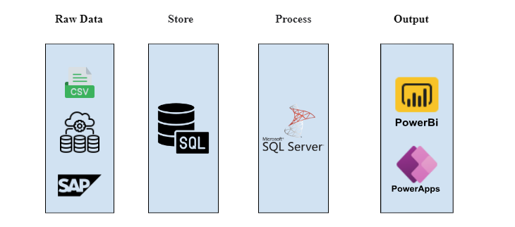


Slide 7
Process Workflow

Slide 8










Blood Bank
Donation Camp
Blood Processing
Blood Storage
Hospital Transfusion Requests
Donor
Camp Information
Disease Testing
Centrifuge Process
Warehouse Location
Inventory Management
Hospital Staff
Patient Requests

Slide 9
Dashboard Walkthrough

Slide 10
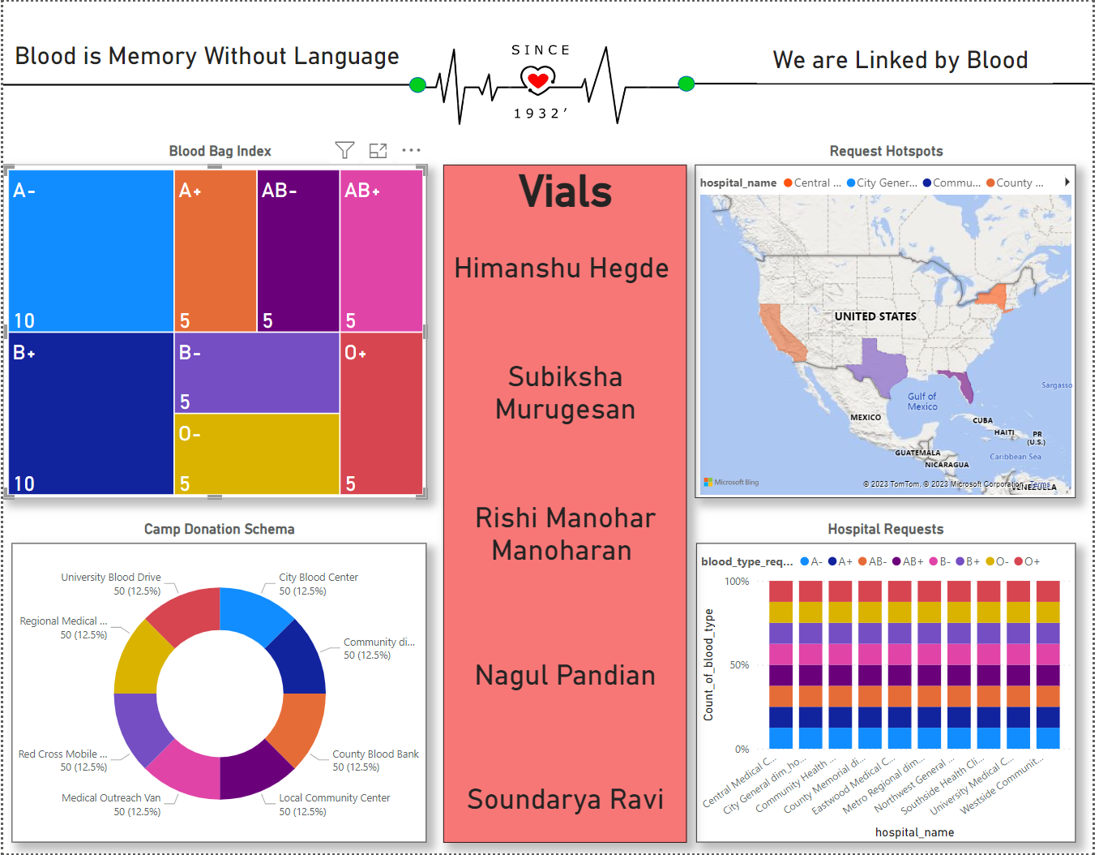
Landing Page
Overview of Blood Bank System
Higher level insight into donation camps, Storage and Transfusion Requests

Slide 11
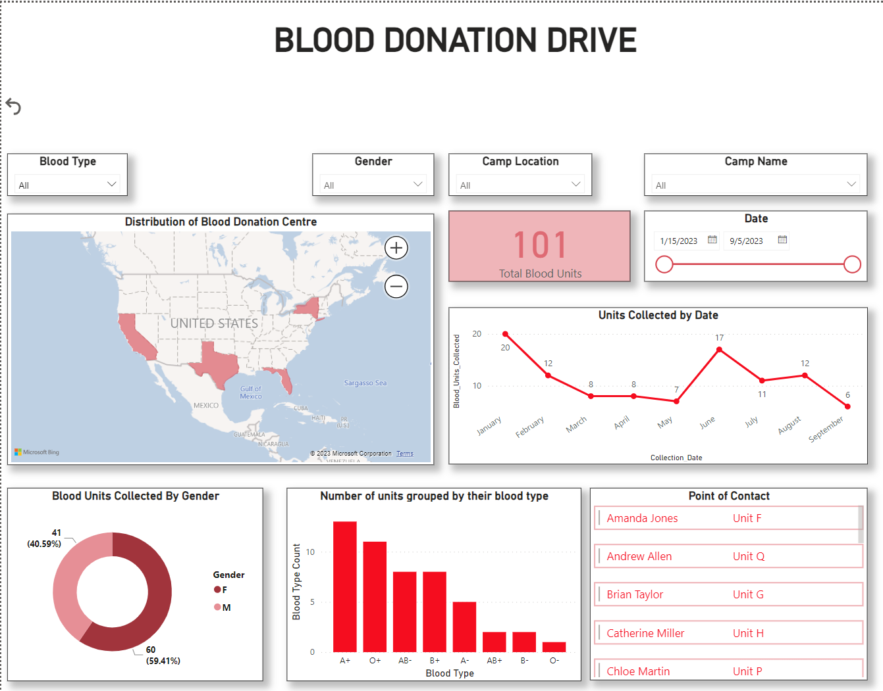
Donation Drive View
Insight into Blood Donation Camps, Quantity and Type of Blood collected across various attributes and tracking blood collection over time.

Slide 12
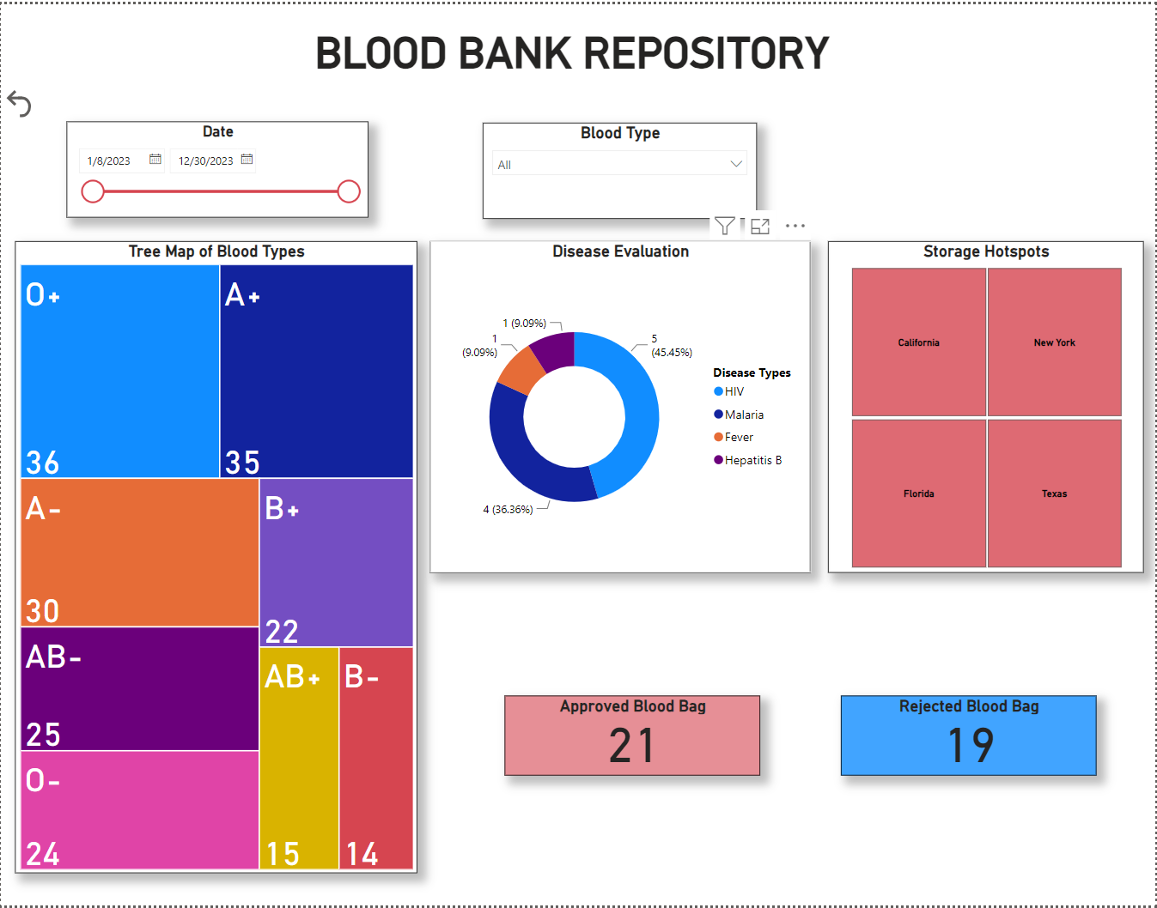
Processed Blood Storage View
Visibility into Blood Bag’s collected, Approval Rate and Blood Units stored across various attributes such as location and time.

Slide 13
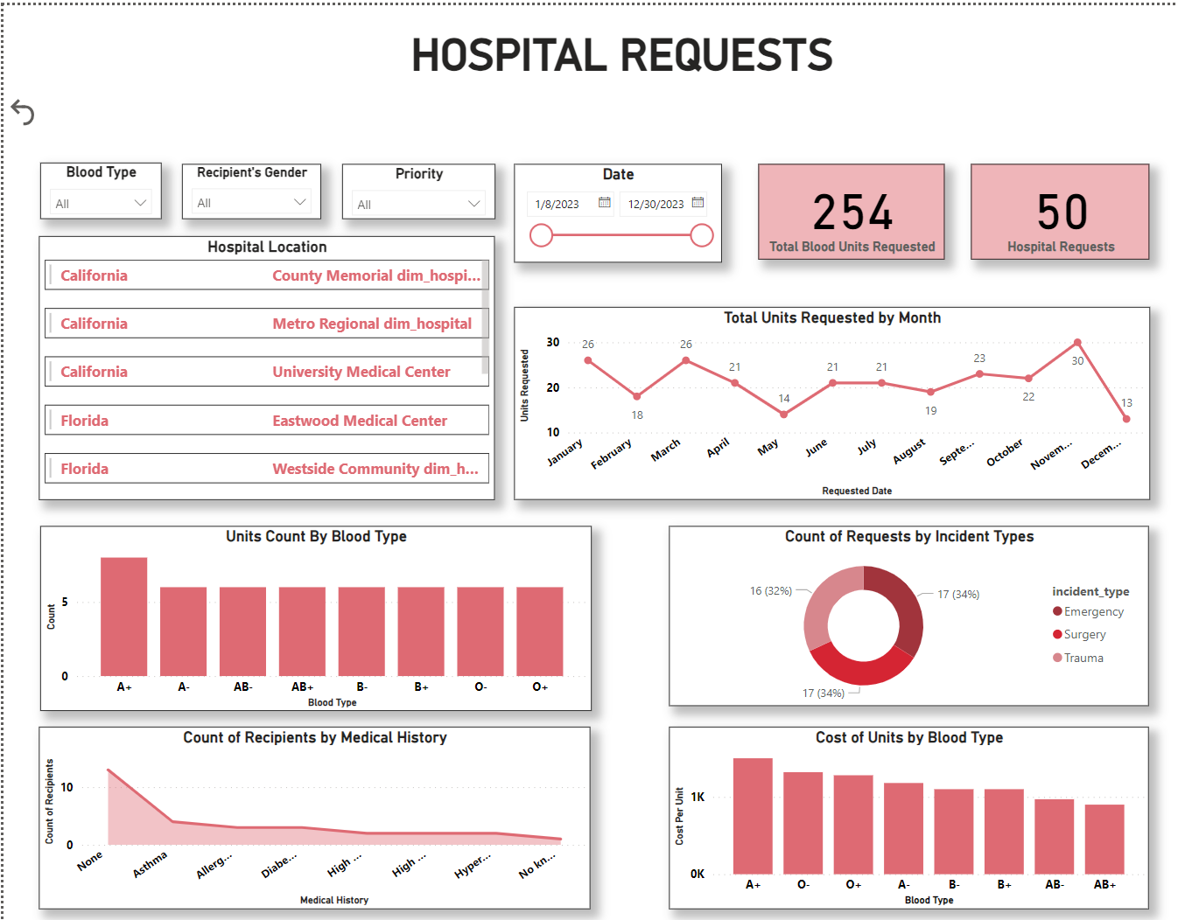
Hospital Transfusion Requests View
Tracking blood requests by Quantity, Blood Type, Incident Type and Cost across various attributes such as Location, Hospital, Date, Priority etc.

Slide 14
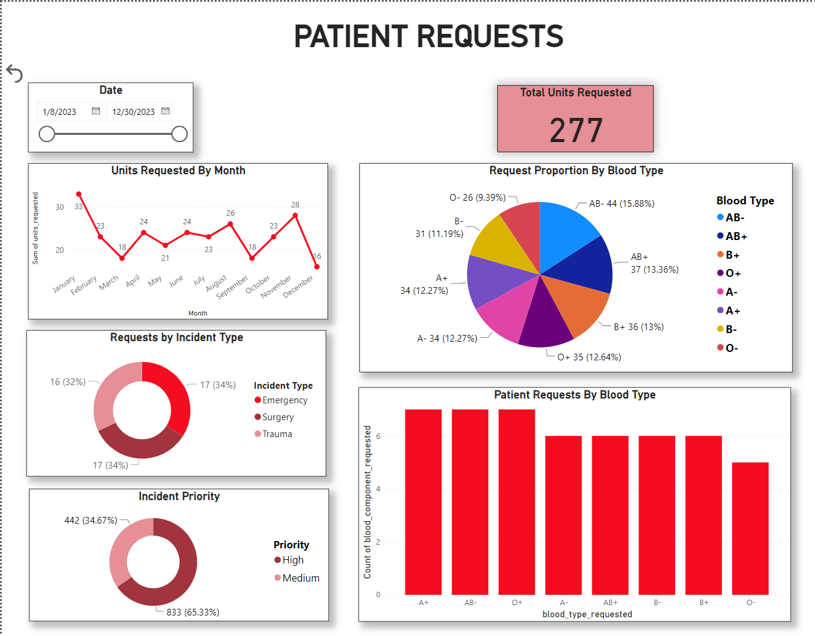
Patient to Hospital Transfusion Requests View
Tracking Patient to Hospital requests by Quantity, Blood Type, Incident Type and Requests over time attributes such as Location, Hospital, Date, Priority etc.

Slide 15
Data Model Walkthrough

Slide 16
Key Concepts used to ensure Data Integrity :
Constraints: Primary keys, Foreign Keys and Unique Constraints.
Triggers to ensure integrity after INSERT/UPDATE statements.
8 Fact and 12 Dim Tables
TableName | RowCounts
dim_donor | 50
dim_hospital | 10
dim_camp | 20
dim_blood_collection | 50
dim_blood_donation_drive | 50
dim_recipient | 30
dim_staff | 20
dim_blood_disease | 50
dim_inventory | 20
dim_component | 5
dim_hospital_staff_details | 50
fact_blood_donation_drive | 50
fact_blood_pre_process_storage | 80
fact_processing_disease_test | 40
fact_processing_centrifuge | 43
fact_storage_inventory | 41
fact_blood_requests | 50
fact_hospital_requests | 50
fact_patient_to_hospital | 50
sysdiagrams | 0
Additional Features:
Stored Procedures: Created to insert data into various Fact Tables.
Views: Created to address key business use cases.

Slide 17
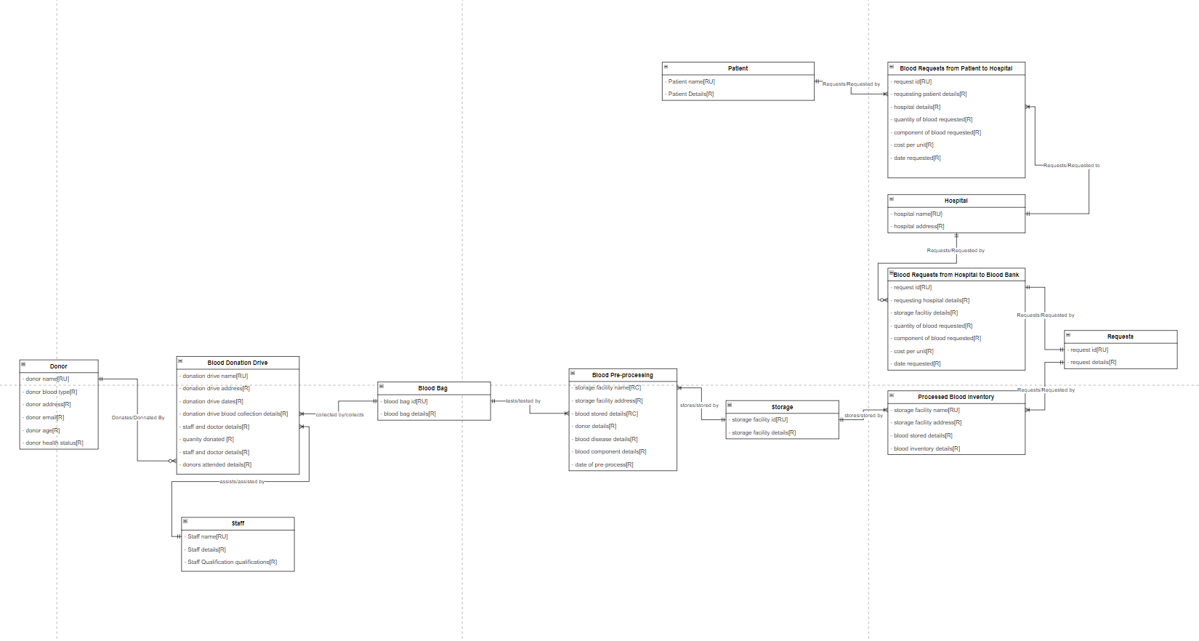
Conceptual Diagram
Conceptual Diagram contains the identified data structure for all 4 major processes in the blood bank pipeline and the relationships between the different entities.

Slide 18
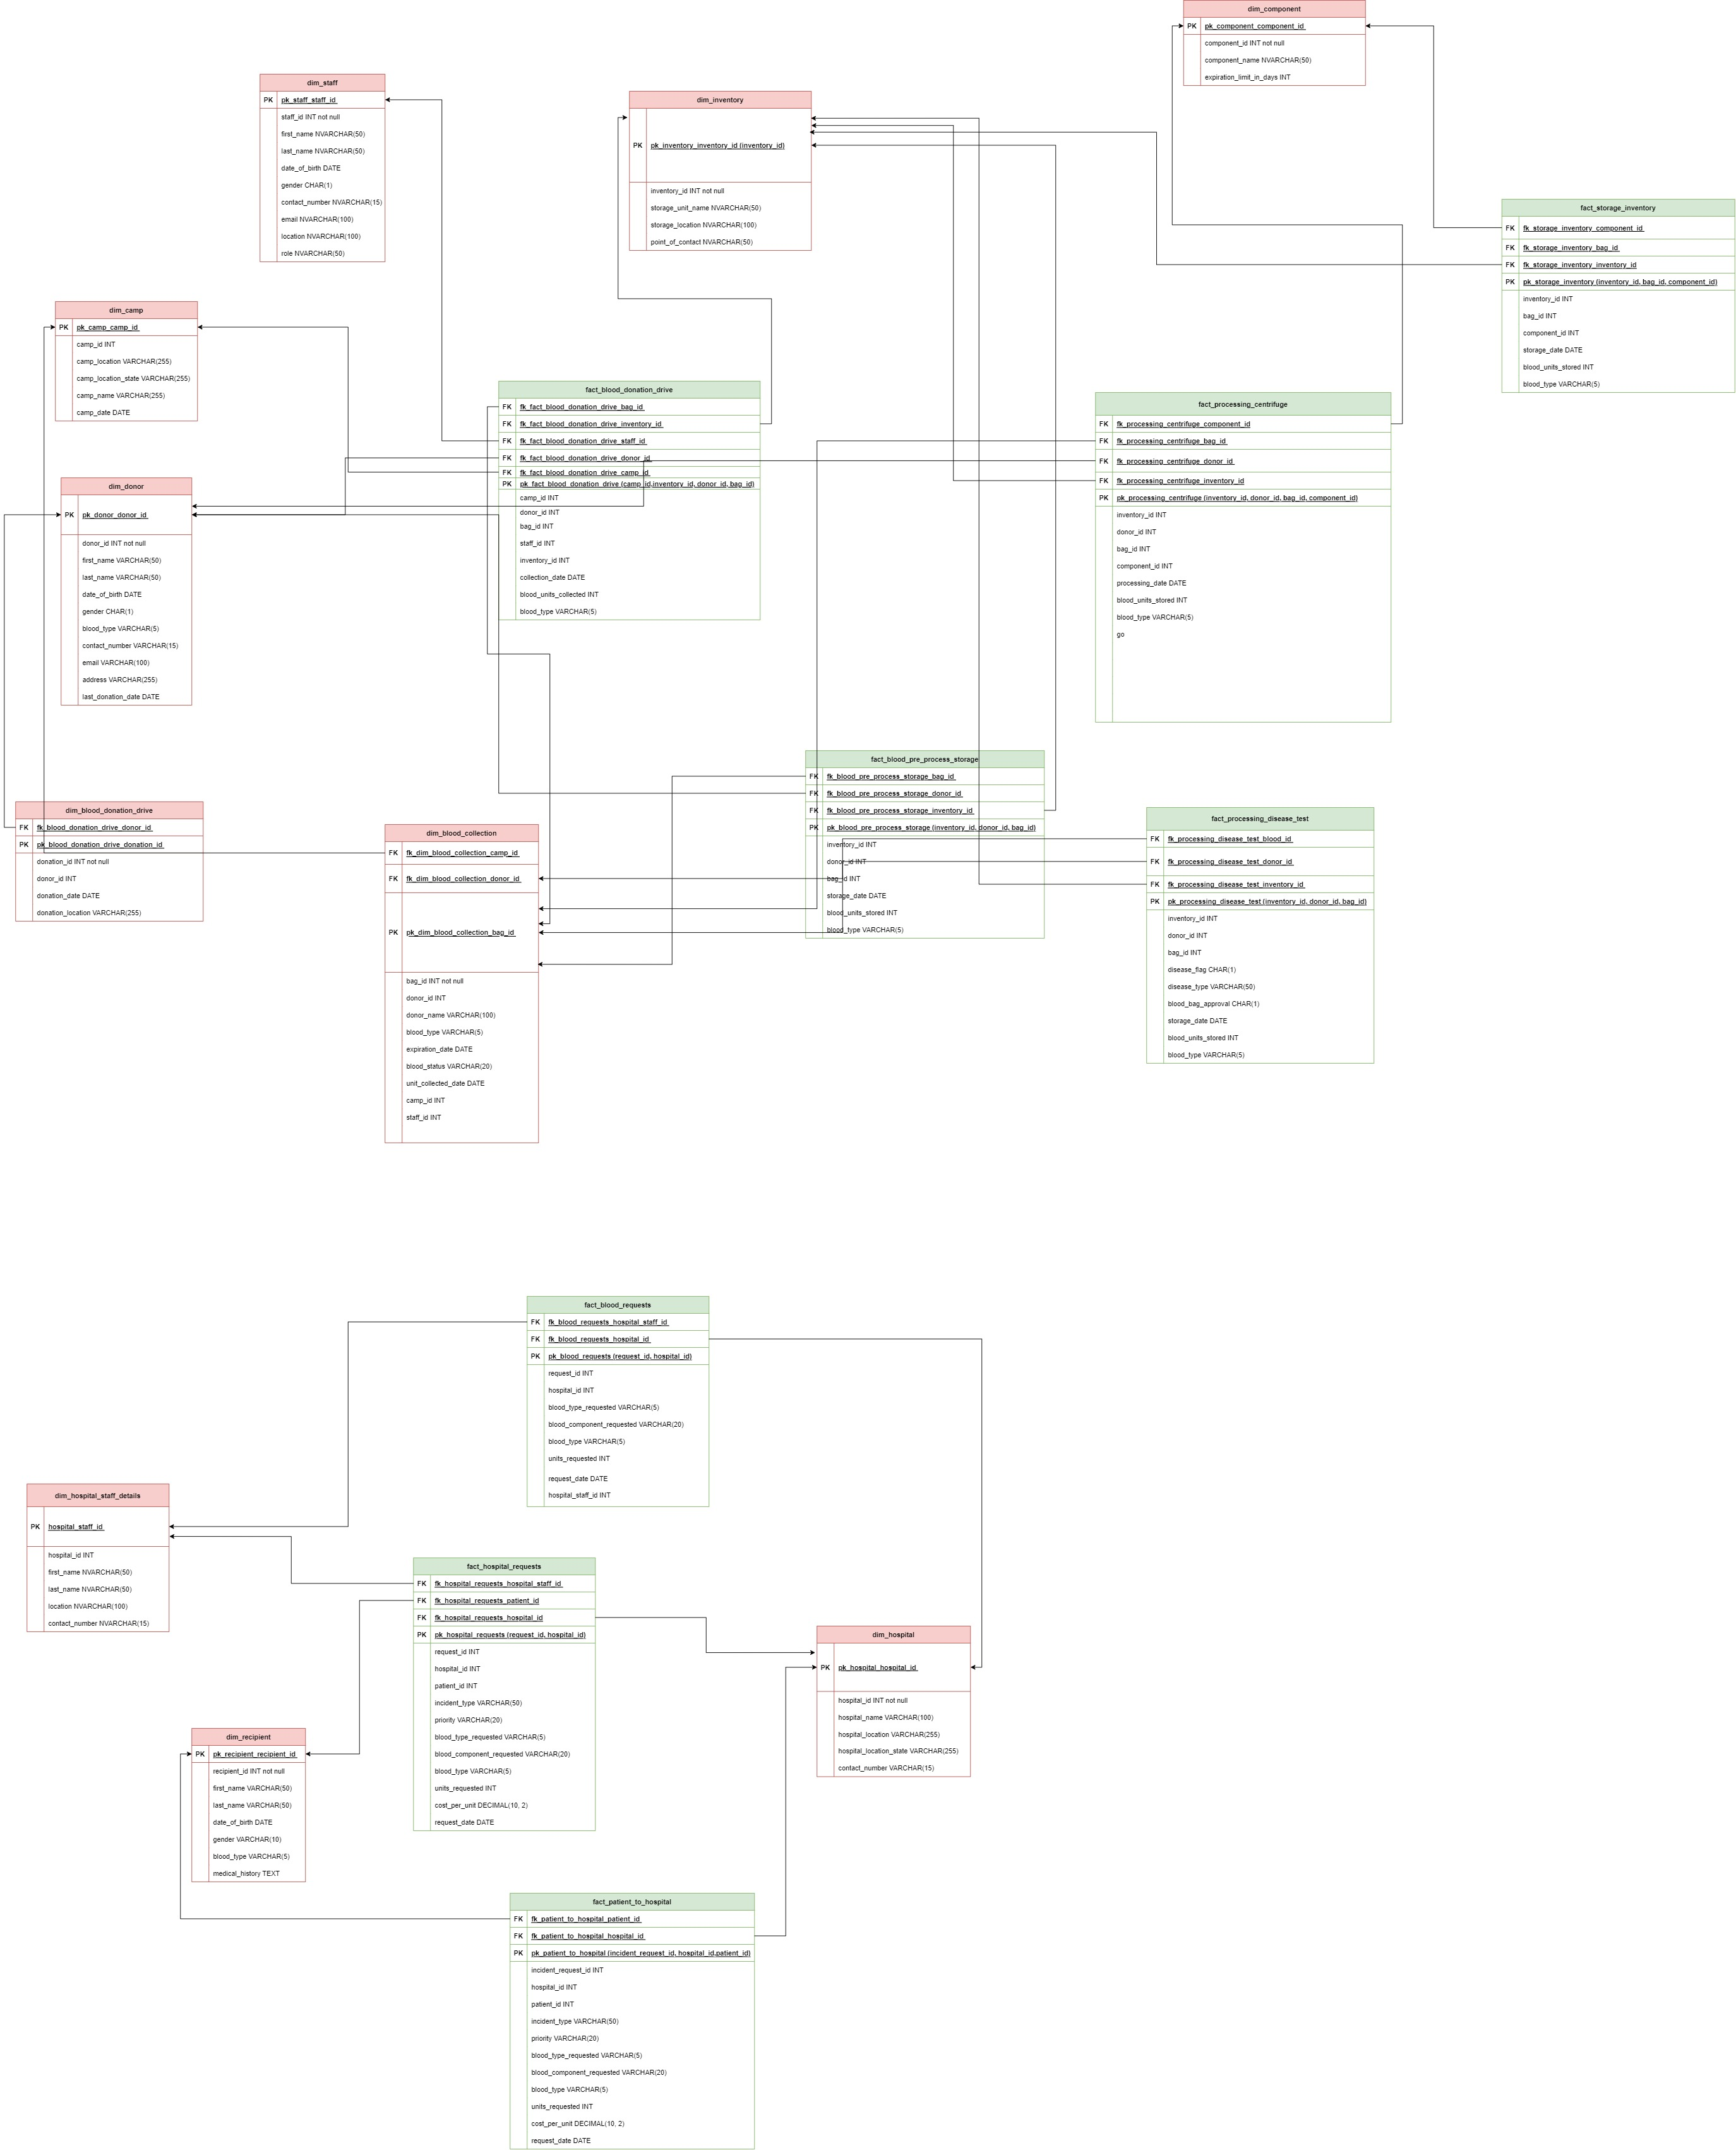
Logical Diagram
Fact Tables indicated in green.
Dim Tables indicated in Red.
8 Fact tables ; 12 Dim Tables

Slide 19
S.No. | Stored Procedure
1 | InsertBloodRequest
2 | InsertPatientToHospital
3 | InsertBloodDonationDrive
Stored Procedures:
3 Stored procedures created to ensure seamless insertion of data into Fact Tables.
No. | Triggers
1 | trg_update_dim_blood_donation_camp_date
2 | trg_update_fact_blood_donation_drive_camp_date
3 | trg_update_fact_blood_pre_process_storage_date
4 | trg_delete_rows_where_blood_bag_has_disease_in_centrifuge
5 | trg_delete_rows_where_blood_bag_has_disease_in_inventory
6 | trg_update_fact_processing_centrifuge_process_date
7 | trg_update_fact_storage_inventory_storage_date
Triggers:
7 Triggers created to ensure integrity of post Insert/Update Operations
Views:
2 Views created for specific business purposes – they are a combination of Fact and Dim Tables.
S.No. | View
1 | vw_blood_donation_drive_details
2 | vw_blood_requests_from_hospitals

Slide 20
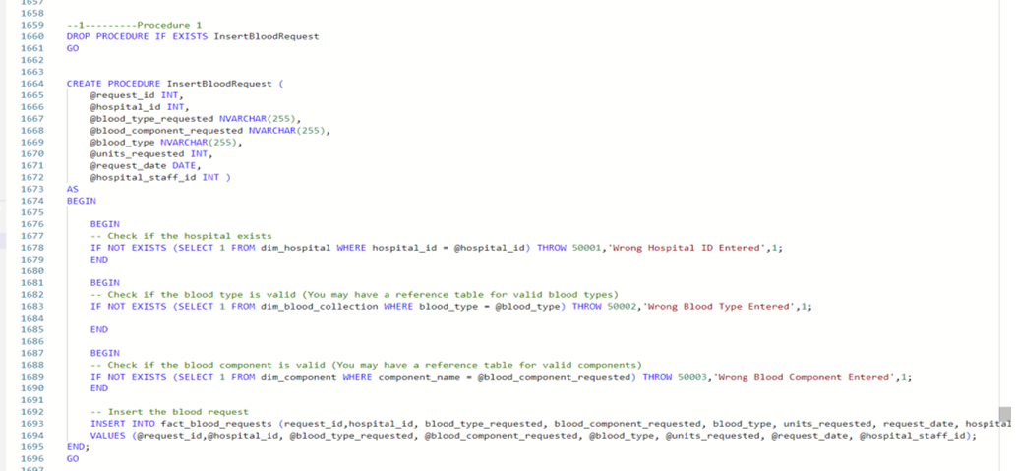
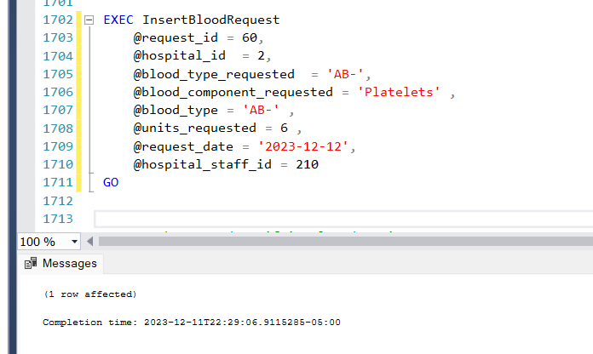
PROCEDURE: INSERT BLOOD REQUESTS

Slide 21
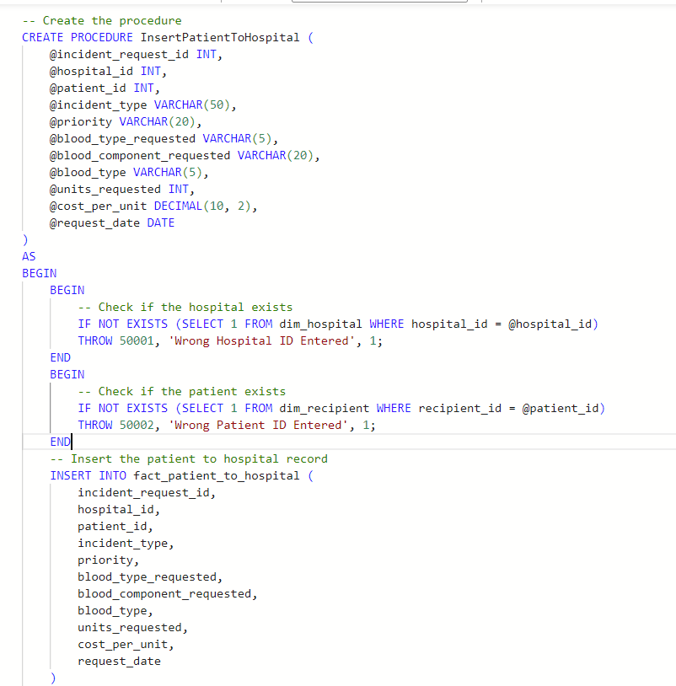
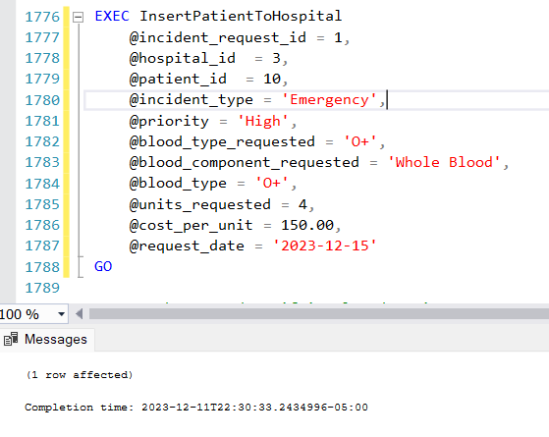
PROCEDURE: INSERT PATIENT TO HOSPITAL

Slide 22
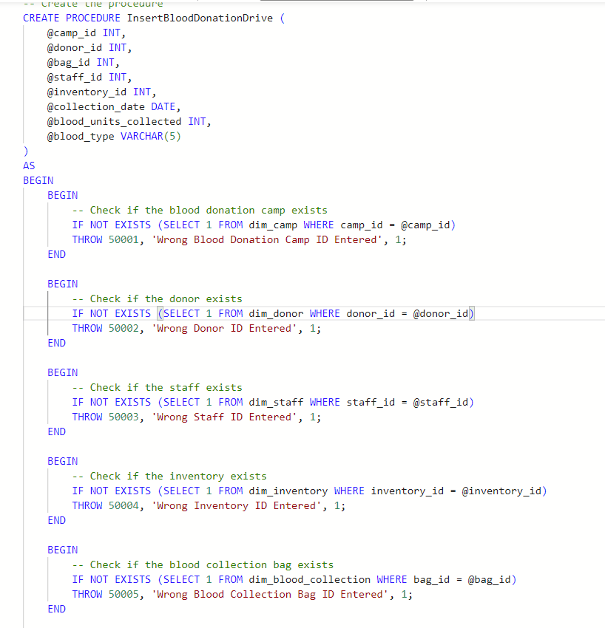
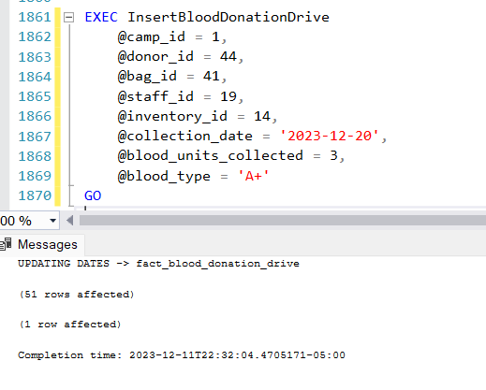
PROCEDURE: INSERT BLOOD DONATION DRIVE

Slide 23
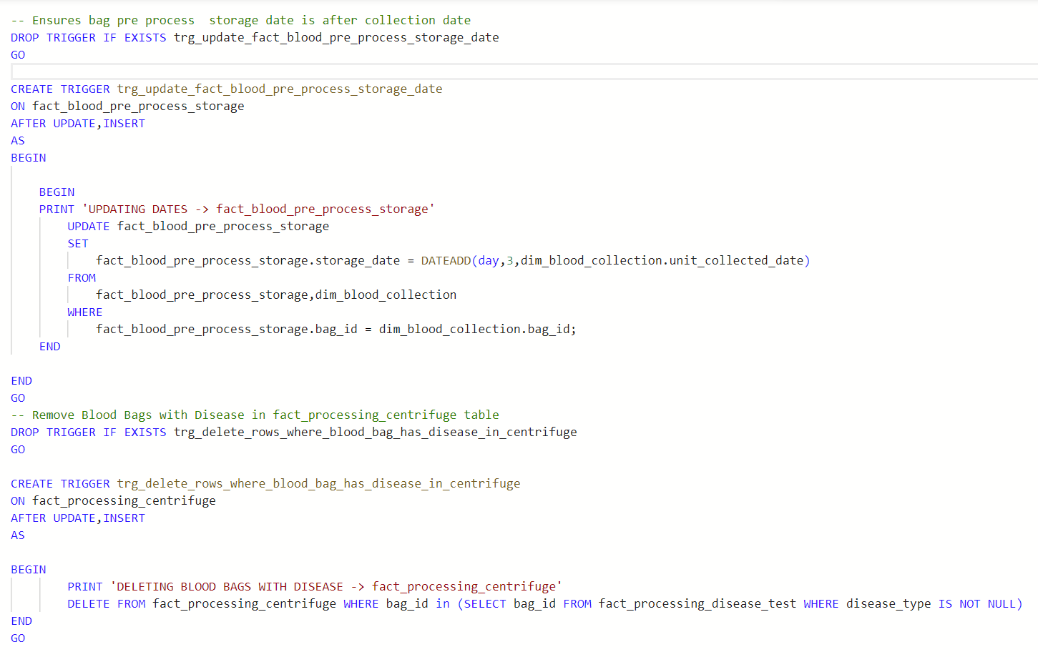
TRIGGER ON RECORDS TO ENSURE INTEGRITY

Slide 24
Views

Slide 25
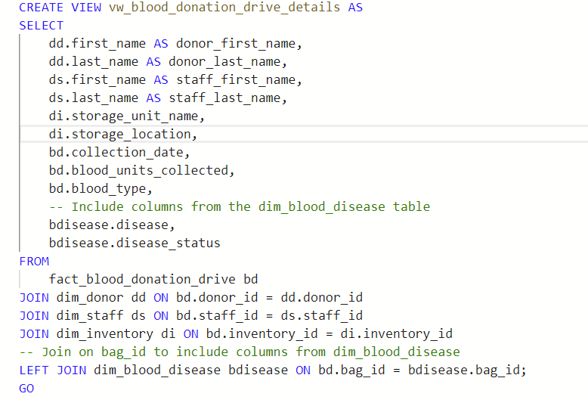
VIEW
BLOOD DONATION DRIVE DETAILS

Slide 26
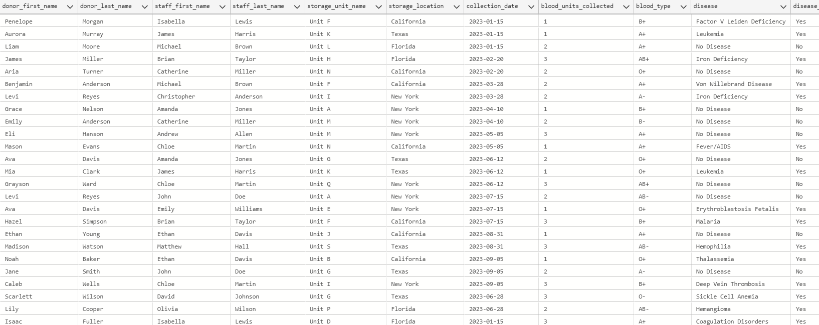

Slide 27
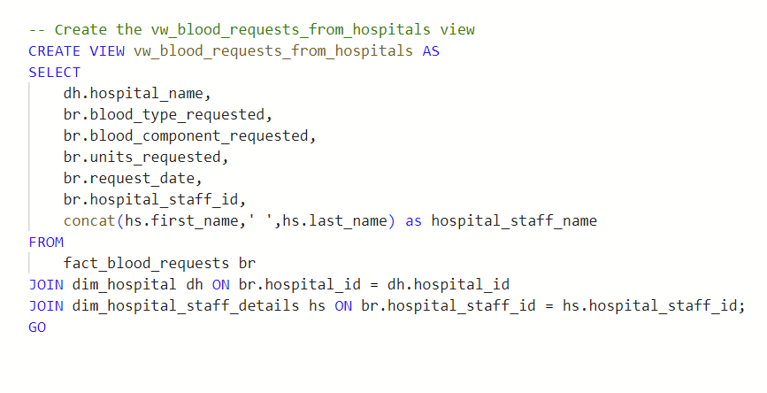
VIEW
BLOOD REQUESTS FROM HOSPITAL

Slide 28
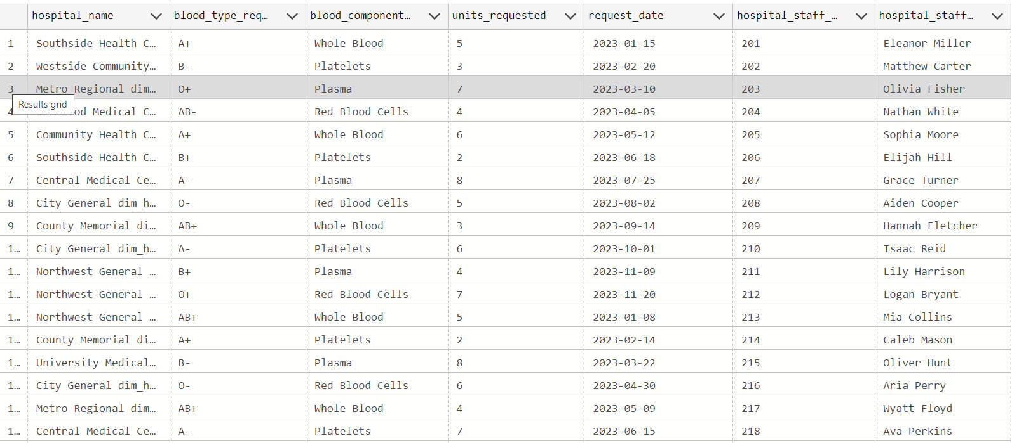

Slide 29
Thank You

Slide 30
Appendix

Slide 31
TEAM MEMBERS | ROLES | WORK DONE | CROSS TRAINING
HIMANSHU HEGDE | Project Manager | - Project Briefing - Tool Analysis - Backend Scripting - Power point Presentation - Final Documentation | SOUNDARYA RAVI
SOUNDARYA RAVI | Data Base Coder | - Backend Scripting - Initial Documentation/Original Project Proposal - Logical Diagram - External Model Requirements Spreadsheet | SUBHIKSHA MURUGESAN
SUBHIKSHA MURUGESAN | UI/UX Developer 1 | - Navigation Diagram - Dashboard Wire Frames - Power BI Front End - Initial Logical Analysis | HIMANSHU HEGDE
RISHI MANOHARAN | UI/UX Developer 2 | - Dashboard Wire Frames - Power BI Front End - Conceptual Modelling | NAGUL CHINNASWAMY R
NAGUL CHINNASWAMY R | Business Analyst | - Dashboard Wire Frames - Front End Mock-Up - Data Synthesing | RISHI MANOHARAN

Slide 32
TEAM LOG - MILESTONES
Owner | Topic | 9 Oct 2023 | 16 Oct 2023 | 23 Oct 2023 | 3 Nov 2023 | 12 Nov 2023 | 29 Nov 2023 | 5 Dec 2023 | 10 Dec 2023
Everyone | All text book Videos + Concepts
Rishi + Nagul+ Subhiksha | Front-end mock-up (Figma/power apps)
Everyone | Front-end mock-up validation
Himanshu + Soundarya+ Subhiksha | Backend Table Design - Brainstorming
Soundarya + Subhiksha | Backend Data Model Diagram (Draw.io)
Soundarya + Himanshu | Building SQL DB Table scripts
Rishi + Nagul + Subhiksha | Front-end Powerapps tool
Everyone | User Testing + Validation
Everyone | Documentation + PPT
Everyone | Cross Training
We are done! YAYYYY

